Slide 1

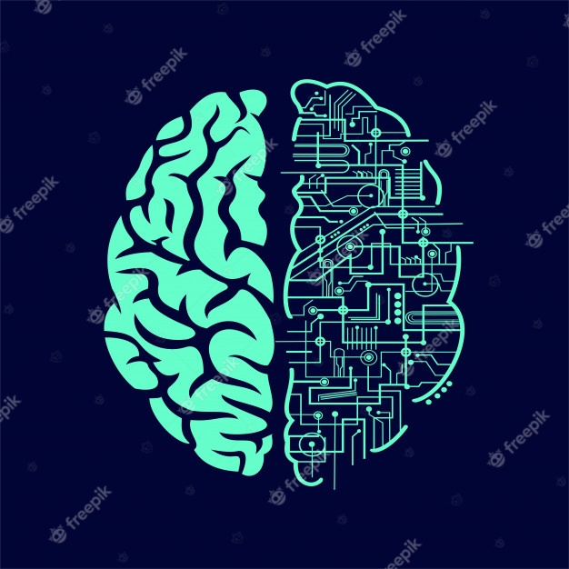
Prediction of biological environment from MRI scans, by Linear Regression & ML methods
By David Cohen - 204150718
Advisor: Professor Aviv Mezer

Slide 2
Prediction of biological environment from MRI scans, by Linear Regression & ML methods
By David Cohen - 204150718
Advisor: Professor Aviv Mezer

Slide 3

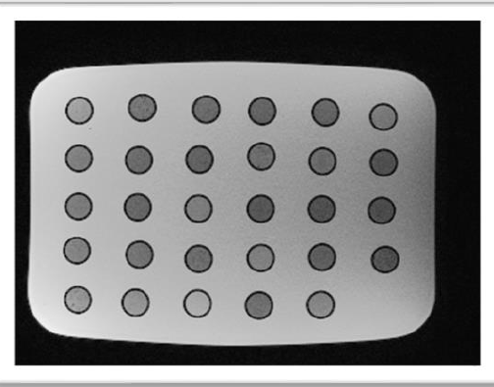

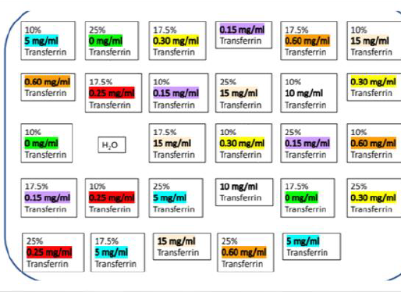
The Data
about 500 samples of water solutions, in the presence of different lipids and iron content (free ions, and protein-bounded).

Slide 4

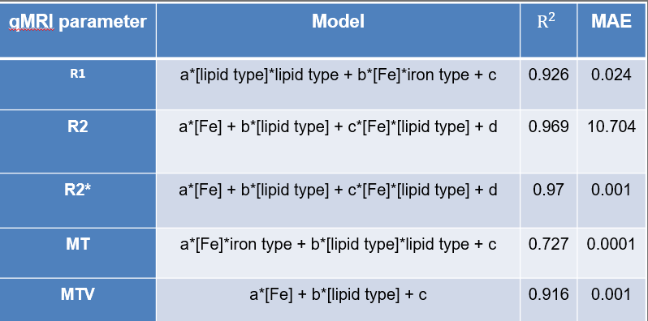

Based on a study done last year that models the MRI results given the biological measurements

Slide 5
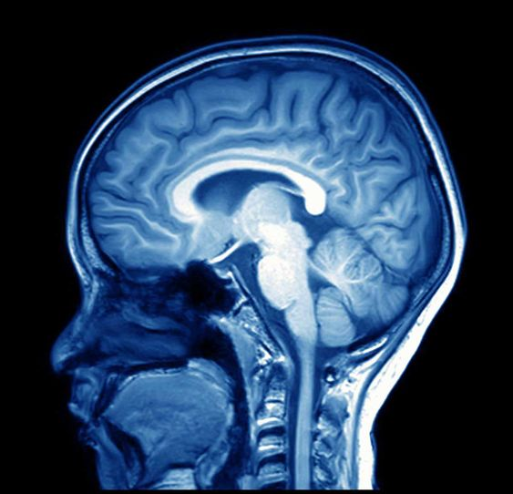
Our goal : Prediction of biological environment from MRI scans
Start with linar regressin on qMRI result (“biased approach”).
continue with A.I methods(“unbiased approach”)

Slide 6

Any questions?

